Slide 1
Termination Discrepancy Fix Automation

Slide 2
Problem Statement
Terminated users are not terminated in downstream applications of SailPoint within a specific tie which creates a discrepancy between source versus target applications
Outcome
Deactivated users are staying Active in downstream system (like AD, OUD, OIG and Lenel) for longer duration after termination which is a huge business risk
high numbers of incidents raised by customer.
 | Data discrepancy Issue Incident for August Month
Example inc | Discrepancy Category | Week 1(1-3) | Week 2(4-10) | Week 3(11-17) | Week 4(18-24) | Week 5(25-31) |  | Total
INC11856655 | BoD Accounts with null job code |  | 1 |  |  |  |  | 1
INC11903823 | New Mexico users being created in SAP |  |  |  |  | 1 |  | 1
INC11858441 | Reevaluate Entitlements |  | 1 |  | 1 | 1 |  | 3
INC11853751 | Rehires/Terms Not Synced | 3 | 4 | 5 | 5 | 5 |  | 22
INC11860832 | Reprocess Breeze Accounts |  | 1 |  |  |  |  | 1
INC11828412 | User Data in OIG/AD Not Matching Workday(Manager,jobcode,location) | 3 | 4 | 5 | 5 | 5 |  | 22
INC11896388 | Remove Role from User |  |  |  | 1 |  |  | 1
 |  |  |  |  |  |  |  | 51
Manual Approach
Team is manually is taking action on fixing the discrepancy and marking the users inactive in target system.

Slide 3
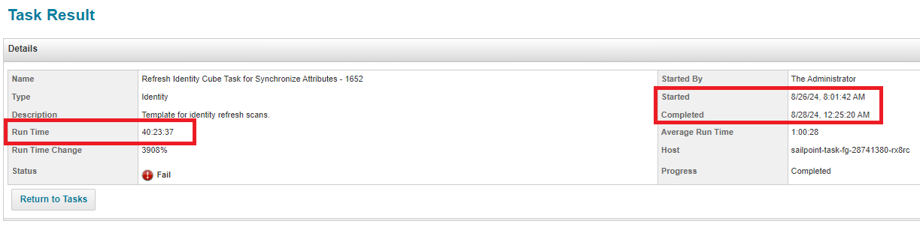
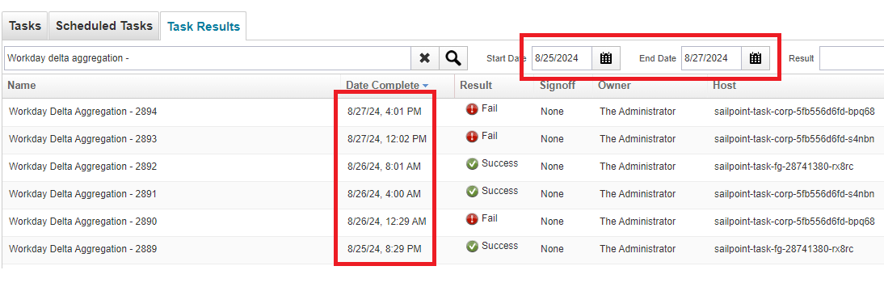
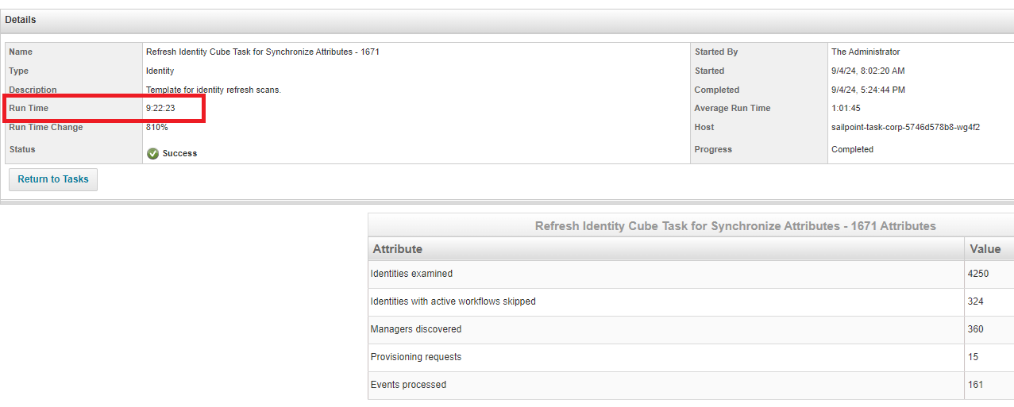
Observations
Delay in refresh of terminated users in SailPoint due to the delay of Workday Delta Aggregation and Sequential Refresh Task. Example below
Between 26th to 27th Aug, Workday Delta Aggregation task got executed only 3 times and failed to execute 2 times, because the latest refresh task took almost 40 hours to complete which eventually got finished on 28th Aug.
Another example on 4th Sept, where refresh sequential task took 9+ hours time to process 4k records which created a delay for the latest users to be refreshed in SailPoint.

Slide 4
Statistics in user level (26th – 30th Aug)
Issue Description | 26th Aug | 27th Aug | 29th Aug | 30th Aug | 31st Aug
Delay In identity refresh before the manual termination disc fix | 77 | 75 | 76 | 108 | 180
Users not aggregated from Workday to IIQ before the manual termination disc fix | 1 | 42 | 25 | 77 | 180
Leaver Event Exception | 5 | 4 | 5 | 4 | 6
Sample Data Collected from our archived reports for example (27th Aug)
Term Users |  | Term Users Active in IIQ | Term users Active in OIG | Term users Active in OIG
list |  | (WD Aggregation) | (Before Single Refresh) | (After Single Refresh & Run Leaver)
A1011745 |  | A110565 | A1011745 | A1633049
A110565 |  | A1288931 | A110565 | A3037206
A1125323 |  | A1307632 | A1125323 | A3093745
A1146977 |  | A1383481 | A1146977 | T502628
A1188188 |  | A1451206 | A1188188
A1191902 |  | A1460855 | A1275012
A1275012 |  | A1547491 | A1288931
A1288931 |  | A1566742 | A1307632
A1307632 |  | A1610145 | A1348285
A1323053 |  | A1645416 | A1383481
A1334952 |  | A1645446 | A1406809
A1344263 |  | A3028546 | A1432697
A1348285 |  | A3032008 | A1451206
A1371478 |  | A3037206 | A1460855
A1372921 |  | A3039105 | A1503411

Slide 5
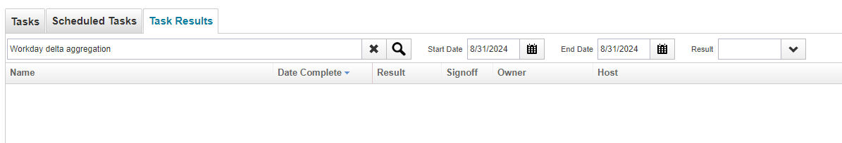
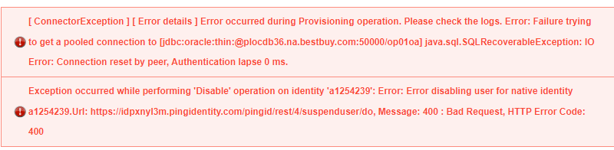
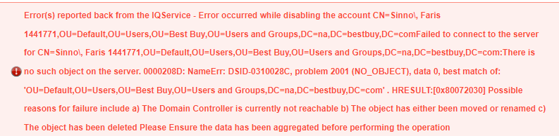
Observations
Past terminated users are not included in Workday daily termination report. Workday create separate ticket for SailPoint to take care such issues. Sample incident# INC11855361, INC1185362 where user#A3081468 and A3071545 terminated more than 60 days in past
Delay in auto launching of Workday Delta Aggregation Task – Restart of servers resolve this issue. Example
On 31st Aug, Workday delta sequential task didn’t run for single time because from 30th Aug evening, the servers were inactive, and no tasks were running at that time. Restarted the servers resolved the issue.
SailPoint Connector Exception while connecting target system during the rapid setup leaver task. Example, User not available in target while triggering the Leaver Event

Slide 6
Existing Manual Process
Our team manually doing termination discrepancy fix everyday after the scheduled “Workday Delta Aggregation” task at pm IST.
Retrieve the terminated users from both SailPoint and Workday in either of these 2 steps.
List of terminated users shared by Workday team at 6pm CST.
Users with effective end date as sysdate from SailPoint.
*** Note: 2nd option is taking if and only if the Workday update don’t come and it happens very occasionally – date: ??
Merge users retrieved from both the reports validate all these users are terminated in SailPoint or not.
Verify user is still Active in SailPoint or not
If Active, MANUALLY check the status of users in Workday.
If Active, then Rehired and no action required
Else, run Workday Bulk Aggregation to terminate those users in SailPoint.
If Inactive, move to Step 5
If Terminated in SailPoint, MANUAL check the status of the users in OIG DB, AD, OUD and Lenel.
If Inactive, no action is required.
Else, run Single Identity Refresh job for those users who are active in OIG DB, AD, OUD and Lenel. MANUAL trigger Leaver event until users get into Inactive state in downstream application.
Note: Workday Report Names are:
Terminated Users within last 60days
Terminate users within last 2 days

Slide 7
Automation Approach
Workday team sends the terminated users’ list to SailPoint and push it in S3 bucket at every midnight PST.
Create a custom task “Termination discrepancy fix custom task” which will reside inside the scheduled task “Workday Delta Aggregation and Identity Refresh Synchronize Attributes Sequential Task”.
Read the file from S3 bucket and retrieve the terminated users one at a time.
Step#1 -- Run Single Account Workday Aggregation task.
Step#2 -- Run Single Identity Refresh for this user.
Step#3 -- Store this user in Custom table in SailPoint with the other attributes like ‘Inactive’ , ‘NEEDS_REFRESH’.
Step#4 -- Repeat the above steps until all users are complete to read
Read the Inactive users from custom table one at a time.
Run Single Account OIG Aggregation task.
Step#1 -- Check the user is active in OIG or not. If Inactive, move to the next user. If Active, move to next step.
Step#2 --Trigger Leaver Event.
Step#3 – Repeat Step 1-2 until user is Inactive in OIG.
Run Single Account Aggregation for other Applications (AD, OUD, Lenel) and run Step 1-3
Schedule reports to provide the below details and send notification with the report in IG mailbox “bby-dl-identitygov”.
Final status of terminated users in target application.
List of discrepant users fixed between WD to SailPoint
List of discrepant users fixed between SailPoint to Target System
List of full termed users shared by WD for the specific date

Slide 8
Move to Next user
Workday Delta Aggregation and Identity Refresh Synchronize Attributes Sequential Task
Workday
Sends the terminated users’ report in 12pm PST
Single Account Workday Aggregation
S3 bucket
4. Termination discrepancy fix custom task
Retrieve single identity
Custom Table
5. Run Target Aggregation Task
Single Identity Refresh
Store User in Custom Table
Trigger Leaver Event
If user Active
5.1 Run Single Identity OIG Aggregation
5.2-4 Run Single Identity AD/OUD/Lenel Aggregation

Slide 9
Effort Estimation
Effort Estimation
Team | Activity | Effort
Workday | Push Terminated users list in S3 bucket | 20
SailPoint | Development | 240
 | Internal Testing | 40

Slide 10
Business Benefit
Assurance from end to end that no terminated user is present anymore in downstream application.
Manual Effort of discrepancy fix can be removed.
Past 6 month's data
Manual Activity | Discrepancy Type | Effort(hour) per Activity |  | last 6 Months count |  |  |  |  |  | Total Effor in last 6 month | Monthly aferage effort
Incident |  |  |  | Aug | July | June | May | Apr | Mar
 |  |  | Count | 22 | 21 | 18 | 12 | 22 | 23
 | Rehired | 2.5 | Total Effor per month | 55 | 52.5 | 45 | 30 | 55 | 57.5 | 295 | 49
 | Terminated | 1 |  | 22 | 21 | 18 | 12 | 22 | 23 | 118 | 20
Discrepancy Fix
 |  |  | Days | 20 | 20 | 20 | 20 | 20 | 20
 | Rehired | 2.5 | Total Effor per month | 50 | 50 | 50 | 50 | 50 | 50 | 300 | 50
 | Terminated | 1 |  | 20 | 20 | 20 | 20 | 20 | 20 | 120 | 20

Slide 11
Thank You

Slide 12
Workday Aggregation task for Terminated users (Midnight PST)
Workday File Transfer
Old tables/files containing historic data
Workday Delta Aggregation and Identity Refresh Synchronize Attributes Sequential Task
Workday Delta Aggregation
Refresh Identity Cube for Synch Attribute
Refresh Identity Cube for Role Assignment
Internal task of IIQ to find the termed users with effective end date as ‘sysdate’
Get the terminated users from WD
Replace the main file/table with latest data and take the backup of old data
4.1 Workday Bulk Aggregation Task for terminated users
4. Refresh Terminated Users Task
Store/verify the termed users in S3 bucket as file OR in custom table
Custom table or file in S3 bucket
Call SPT_IDENTITY to retrieve User Status, Employee Number, Inactive, NEEDS_REFRESH
SPT_IDENTITY table
Fetch Users from Custom table to do bulk WD Aggregation
NEEDS_REFRESH = 0
Inactive = true
Confirmed all users are refreshed with NEEDS_REFRESH = 0, Discard ‘Active’ users as they REHIRED. Accept only users with Inactive = true
update the value CUSTOM_LEAVER = 1 in custom table
Ensure all users are refreshed with NEEDS_REFRESH value 0
Feed the users in WD Bulk Aggregation & Bulk single Identity refresh task at same time
Connect IIQ DB/ Read File
OIG Bulk Aggregation Single Account
Workday Bulk Aggregation task is complete
Verification of below values from respective applications.
USER_STATUS = ACTIVE in OIG
userAccountControl = 514, bbyHREmployeeStatus = Inactive in AD
ds-pwp-account-disabled = true, bbEmploymentStatus = Inactive in OUD
EMP_TYP_CDE, EMP_STAT_CDE = Inactive in Lenel
4.2 Bulk Single Identity Refresh Task
AD Bulk Aggregation Single Account
If true
Trigger Leaver Event for those users CUSTOM_LEAVER = 1
1. Task: BBY Update Rapid Setup Attribute Task
2. Rule: WDBulkAggregation
3. Run 'Single Identity Refresh Job'
OUD Bulk Aggregation Single Account
updated the value CUSTOM_LEAVER = 1 in custom table
LENEL Bulk Aggregation Single Account
Else Exit

Slide 13
Key changes in Automation Steps
Creation of Custom table/file with custom column along with selective attributes which will hold only terminated users for the day.
Run Full Workday Aggregation for all those users irrespective of manual validation in Workday in manual discrepancy fix
Run single identity refresh for all those users irrespective of manual validation in downstream application.
Run Bulk Account Aggregation of all downstream applications instead of manual checks in each applications.

Slide 14
Root Cause (Cont.)
Workday don’t include the past terminated users’ details in their daily termed users’ report.
Long running FG instances create obstacle in auto launching of scheduled sequential tasks.
SailPoint Connector Exception while connecting target system during the rapid setup leaver task.
User not available in target while triggering the Leaver Event

Slide 15
Workday Aggregation task for Terminated users (Midnight PST)
Workday File Transfer
Old tables/files containing historic data
Workday Delta Aggregation and Identity Refresh Synchronize Attributes Sequential Task
Workday Delta Aggregation
Refresh Identity Cube for Synch Attribute
Refresh Identity Cube for Role Assignment
Internal task of IIQ to find the termed users with effective end date as ‘sysdate’
Get the terminated users from WD
Replace the main file/table with latest data and take the backup of old data
4.1 Workday Bulk Aggregation Task for terminated users
4. Refresh Terminated Users Task
Store/verify the termed users in S3 bucket as file OR in custom table
Custom table or file in S3 bucket
Call SPT_IDENTITY to retrieve User Status, Employee Number, Inactive, NEEDS_REFRESH
SPT_IDENTITY table
Fetch Users from Custom table to do bulk WD Aggregation
NEEDS_REFRESH = 0
Inactive = true
Confirmed all users are refreshed with NEEDS_REFRESH = 0, Discard ‘Active’ users as they REHIRED. Accept only users with Inactive = true
update the value CUSTOM_LEAVER = 1 in custom table
Ensure all users are refreshed with NEEDS_REFRESH value 0
Feed the users in WD Bulk Aggregation & Bulk single Identity refresh task at same time
Connect IIQ DB/ Read File
OIG Bulk Aggregation Single Account
Workday Bulk Aggregation task is complete
Verification of below values from respective applications.
USER_STATUS = ACTIVE in OIG
userAccountControl = 514, bbyHREmployeeStatus = Inactive in AD
ds-pwp-account-disabled = true, bbEmploymentStatus = Inactive in OUD
EMP_TYP_CDE, EMP_STAT_CDE = Inactive in Lenel
4.2 Bulk Single Identity Refresh Task
AD Bulk Aggregation Single Account
If true
Trigger Leaver Event for those users CUSTOM_LEAVER = 1
1. Task: BBY Update Rapid Setup Attribute Task
2. Rule: WDBulkAggregation
3. Run 'Single Identity Refresh Job'
OUD Bulk Aggregation Single Account
updated the value CUSTOM_LEAVER = 1 in custom table
LENEL Bulk Aggregation Single Account
Else Exit

Slide 16
Observations
Delay in refresh of terminated users in SailPoint due to delay in Workday Delta Aggregation and Sequential Refresh Task.
Past terminated users are not included in Workday daily termination report. Workday create separate ticket for SailPoint to take care such issues. Sample incident# INC11855361, INC1185362 where user#A3081468 and A3071545 terminated more than 60 days in past
Delay in auto launching of Workday Delta Aggregation Task – Restart of servers resolve this issue
SailPoint Connector Exception while connecting target system during the rapid setup leaver task.
User not available in target while triggering the Leaver Event.

Slide 17
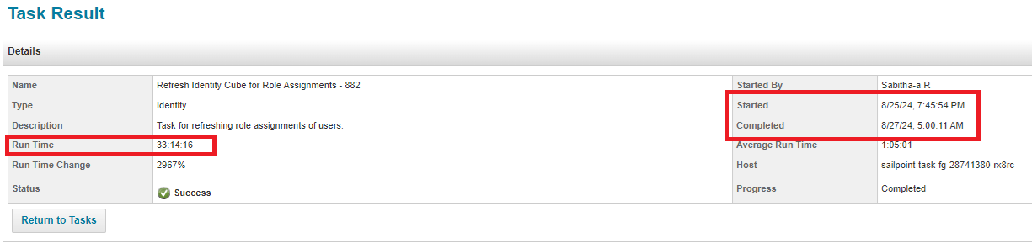
Key issues highlighted in 26th – 31st Aug
On 26th Aug, Workday Delta Aggregation task didn’t execute more than 3 times, because the following refresh task took 40 hours to complete, and it was finished 2 days later. This is Delay In Identity Refresh Task.
On 26th Aug, Refresh Task for Role Assignment didn’t execute for single time, because the previous Role refresh task took Almost 33 hours, and it was finished 2 days later. This is Delay In Refresh Task in role assignment.
On 31st Aug, Workday delta sequential task didn’t run for single time because from 30th Aug evening, the servers were inactive, and no tasks were running at that time. Restarted the servers resolved the issue

Slide 19
Automation Solution
Workday team will manually push the terminated user list in SailPoint server.
Create a custom task at 2am CST everyday. This task will read the data from the terminated users’ list shared by Workday.
Create a custom file in SailPoint server and store those users with selective attributes (User Status, Employee Number, Inactive, NEEDS_REFRESH) in that custom table/file.
Run sequentially “Bulk Workday Aggregation” and “Bulk Single identity Refresh” task for the users stored in custom table.
Ensure all those users are Aggregated and Refreshed, Discard the ‘Active’ users and consider ‘Inactive’ users.
Run sequential downstream application (OIG, AD, OUD, Lenel) Aggregation task to get the latest status of those users in SailPoint.
If those users are found as ‘Active’ after Aggregation, then auto trigger Leaver event for those users again

Slide 20
Business Benefit
Assurance from end to end that no terminated user is present anymore in downstream application.
Manual Effort of discrepancy fix can be removed.
Past 6 month's data
Manual Activity | Discrepancy Type | Effort(hour) per Activity |  | last 6 Months count |  |  |  |  |  | Total Effor in last 6 month | Monthly aferage effort
Incident |  |  |  | Aug | July | June | May | Apr | Mar
 |  |  | Count | 22 | 21 | 18 | 12 | 22 | 23
 | Rehired | 2.5 | Total Effor per month | 55 | 52.5 | 45 | 30 | 55 | 57.5 | 295 | 49
 | Terminated | 1 |  | 22 | 21 | 18 | 12 | 22 | 23 | 118 | 20
Discrepancy Fix
 |  |  | Days | 20 | 20 | 20 | 20 | 20 | 20
 | Rehired | 2.5 | Total Effor per month | 50 | 50 | 50 | 50 | 50 | 50 | 300 | 50
 | Terminated | 1 |  | 20 | 20 | 20 | 20 | 20 | 20 | 120 | 20

